Slide 1
Universal Health Coverage
Experience from Meghalaya
Sampath Kumar
September 25, 2022

Slide 2
We have been using the State Capability Enhancement Project (SCEP) approach that aims to build state capability by solving critical development challenges in Meghalaya.

Slide 3
Mission
Trajectory
We started by mapping common Technical Challenges
We brought
State Capability
Enhancement approach
District reviews (PDIA) and analysis revealed deeper Socioeconomic
Issues
We brought
State Health
Policy
Deficient Health Infrastructure
Lack of Trained Human Resources
Geographical challenges and Transportation Issues
Default explanations like vaccine hesitancy / low levels of health seeking behaviour
Bring clarity of purpose at all levels, including political
PDIA: iterative, problem-solving
Data & feedback loops for learning
Collaboration between depts & across hierarchies
Gender Issues: Matrilineal Society but low women’s agency
Low Birth Spacing
Teenage Pregnancy
Anaemia
Poverty & low trust: Causing low demand for healthcare
But policy is not enough:
Low implementation capability
Lack of sense of purpose in our systems
Poor coordination among functionaries
Adaptive
Challenges
Notes:
Adaptive Leadership: Framework for how values, identities and loyalties of individuals and groups can be mobilized to overcome barriers to social change
SCEP Framework: principles for mobilizing local leadership, and systematically building on local successes (our own experiences and lessons)
- Kumar, S., Aroon P. Manoharan, Jayasharadha Chandrakalatharan (2021). Applying Competencies: State Capability Enhancement Project (SCEP)

Slide 4
Meghalaya Health Policy 2021 provides the guiding framework (3- dimensional) for UHC in the state
PREVENTIVE
Demand + Supply side interventions
Equitable access
Nutrition and Fitness
Early diagnosis - PPHM
Health Education
MHIS
CPHC
CURATIVE
ENABLING
Health Institutions
Primary, Secondary and Tertiary Care
MHIS / PM-JAY
Telemedicine
CHCs as FRUs
Policy + Measures
Village Health Councils
Capability building
Gender Equality - VEC
Social Audit
ECD Mission
CM-SMS

Slide 5
UHC as Defined by World Health Organization
UHC means that all individuals and communities receive the health services they need without suffering financial hardship. It includes the full spectrum of essential, quality health services, from health promotion to prevention, treatment, rehabilitation, and palliative care across the life course.

Slide 6
Translating Principles to Practice
Cover All Individuals & Communities
Full Spectrum of Services
Across
the Life Course
Eliminate Financial Hardship
CPHC (Mission Govt)
+
Positive Public Health Management (Leveraging AI)
Village Health Councils
ECD
Mission
Megha Health Insurance Scheme / PM-JAY
Chief Minister’s Safe Motherhood Scheme

Slide 7
Positive Public Health Management
Driving a paradigm shift from disease management to Disease Prevention through community mobilisation and by leveraging digital technology and AI
Sensitization
Health Screening
Investigation
Intervention
Information sharing
Participatory discussions
Seasonal diseases calendars
Local determinants of illnesses
Screening against 40 locally relevant health parameters
Digital records
Blood sample diagnosis
Cloud based core clinical intelligence and support system
Data sent to health professionals for final diagnosis
Timely Check-ups
Telemedicine follow-ups
Health Professionals leverage data to identify health trends and design interventions
Designing Prevention strategies
Tests are suggested as per age group and gender, and span across common NCDs such as Hypertension, Diabetes, Thyroid, Cholesterol, Prostate cancer screening, Vitamin A, D, and B12 deficiencies.
Pilot Experiment under Smart Village Movement Project in collaboration with UC Berkeley and Maya MD App

Slide 8
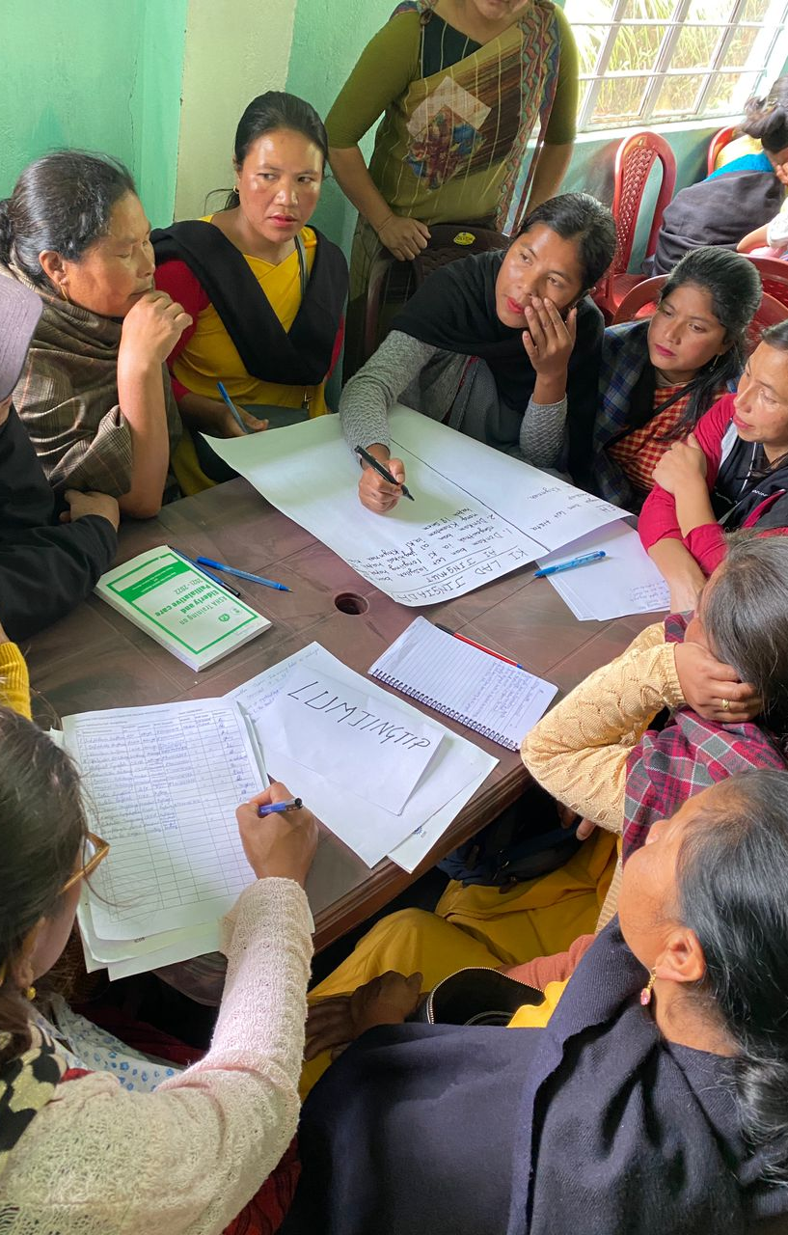
Village Health Councils
Building strong community institution for community action and ownership on health and nutrition.
Discuss common health challenges and facilitate local problem solving and action.
Hold state systems accountable for delivery of services by highlighting gaps and needs
Implement health infrastructure projects based on the need of the community

Slide 9
ECD Mission
Challenges
Approach
Our current systems have a narrow focus on nutrition and cognitive development aspect is sidelined
We are providing supplementary nutrition (SNP), but it is not locally sensitive
There is limited community ownership of Anganwadi Centres (AWC)
We don’t have any robust practice of home visits to coach parents on early childhood development
Health & Nutrition
Mental Stimulation
1
2
Egg and hot-cooked meals for children and pregnant and lactating women
PLA for improving health outcomes
AWCs to provide early childhood education activities
Children to spend one fourth of their time at AWC in a stimulating environment
ECD
Mission
3
Coaching Parents
Regular home visits and fortnightky VHC / VO meetings to:
Sensitize parents on the importance of early childhood period
Coach parents on positive parenting and healthy diets

Slide 10
Megha Health Insurance Scheme – PM-JAY
universal health insurance scheme that provides health insurance to all residents of the state.
Take up preventive health is low in the state | OPD Coverage of INR 30,000 for maternity and childcare care, antenatal care, etc.
Low registration, particularly in remote areas | Facilitate easy registration at the point of care
Low awareness about the scheme | SHG network and VHCs being used to spread awareness
Innovations to Address Local Challenges

Slide 11
CM Safe Motherhood Scheme
People and frontline workers face issues with transportation
MOs can hire vehicles (even 4x4 if needed) for both frontline workers and women
Sector Teams can start transit homes where women and their partners can stay for up to 10 days before EDD
Women don’t come early for delivery as they worry about cost and logistics
Women prefer to deliver at home because they are concerned about their other children
Women can bring their children to the transit home where they will be given proper care and nutrition
Many women trust TBAs and are more comfortable working with them
Women can bring their TBAs along with them to the transit home and for delivery

Slide 12
Data Trends

Slide 13
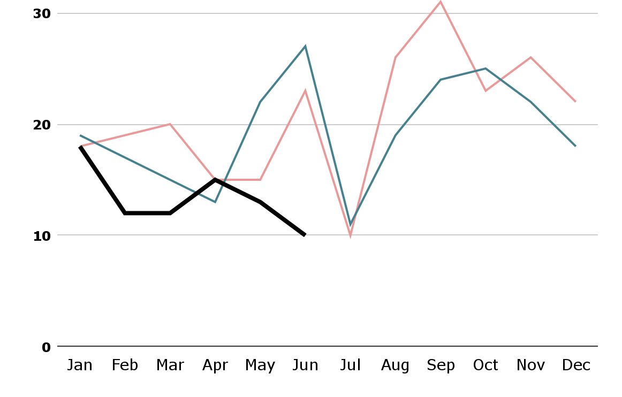
Maternal Deaths
2020
2021
2022
Jan to Mar
Apr to Jun
18% Reduction
(from 2021 to 2022)
2020 | 57
2021 | 51
2022 | 42
2020 | 55
2021 | 64
2022 | 38
40% Reduction
(from 2021 to 2022)

Slide 14
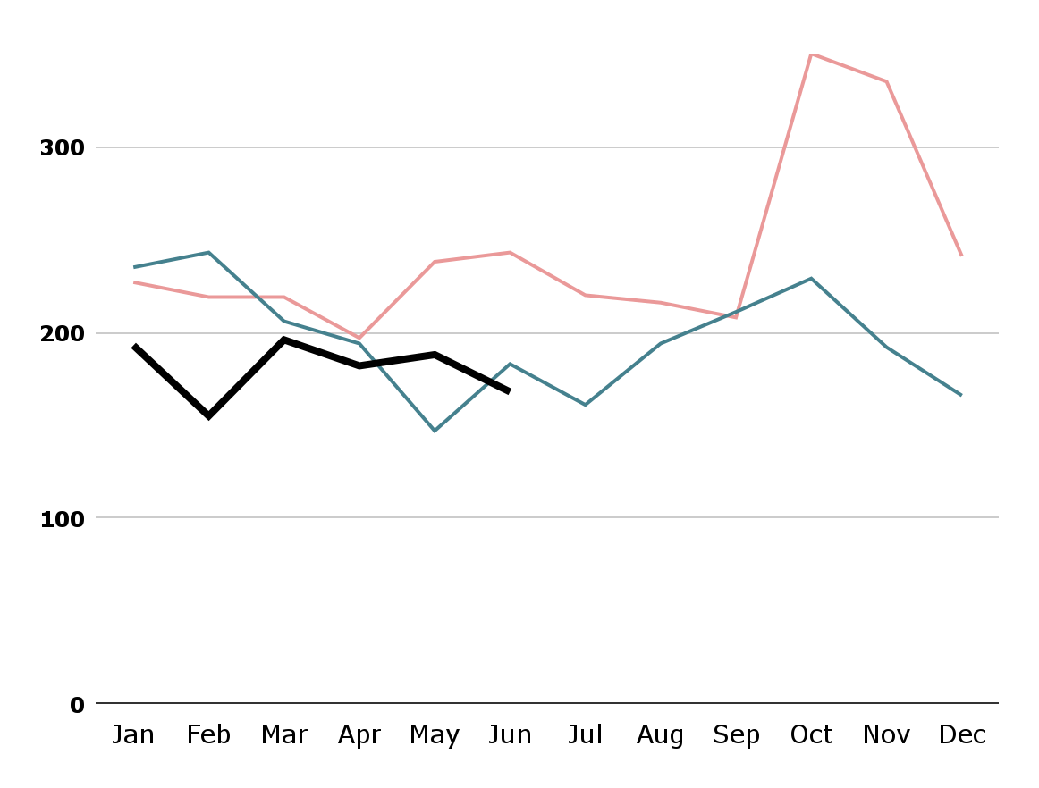
Infant Deaths
2020
2021
2022
Jan to Mar
Apr to Jun
20% Reduction
(from 2021 to 2022)
2020 | 665
2021 | 684
2022 | 544
2020 | 678
2021 | 524
2022 | 538

Slide 15
Appendix

Slide 16
Local leadership through Problem-Solving
Citizen-State Relationship: Responsive Systems
Political Supportability
Six Pillars of
State Capability
Enhancement
Identify & Address Systemic Challenges
Effective Use of Data & Research
Accountability & Agency

Slide 17
Thank you!
“The size of your dreams must always exceed your current capacity to achieve them. If your dreams do not scare you, they are not big enough”
Ellen Johnson Sirleaf 2011

